Slide 1

Washington State Databreach Assessment
An exploratory analysis of reported data breaches in Washington State.
-Isaac Hanes

Slide 2
Introduction
Organizations are required to report if a breach affects 500 or more Washingtonians.
May optionally report if the number affected is less than 500.
Not all the organizations are based in Washington State, some may be out of state, but are required to report to the state when Washington residents are affected.

Slide 3

Purpose
To ask questions and leverage those questions to draw useful statistical conclusions.
To provide insight into patterns in the data.
To identify methods and actions that could help draw definitive conclusions from the data in the future.
Notes:
I will not draw conclusive, non-definitive conclusions.

Slide 4

EDA
945 rows and 24 columns
Dropped columns: ‘Id’, ‘YearText, ‘Year’, and ‘EndedOnDayDiscovered’
CyberattackType column modified where any DataBreachCause entry states "Cyberattack" and CyberattackType states "NaN" to be better represented by "Unreported"
Notes:
State here why columns were dropped: The first three have repeat functionality. The fourth does not provide useful information due to parameters.

Slide 5
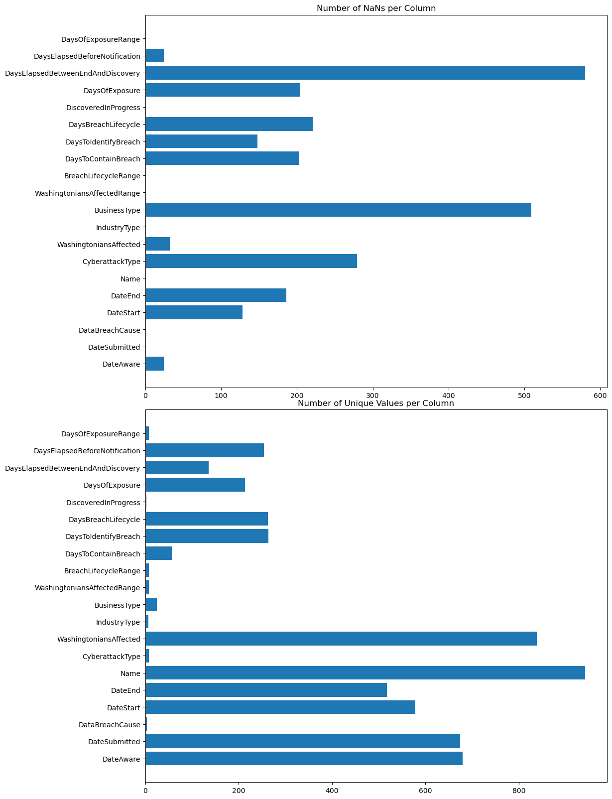
Database Statistics
Notes:
not every event will fit into every category. many of the missing values are due to input on part of the organizations responsible for submitting their reports.

Slide 6

Minimum Viable Product
At a minimum I will provide the organization, display, and description of most pertinent collections of information contained in the database, as well as provide access to my tools and methods for doing so.

Slide 7

Conclusive Information
Following are three sections: Statistical Discoveries, Patterns, & Outliers and Major Discoveries.
Each of these sections contains detailed information following their header.
Each entry includes graphical representations and descriptions.

Slide 8
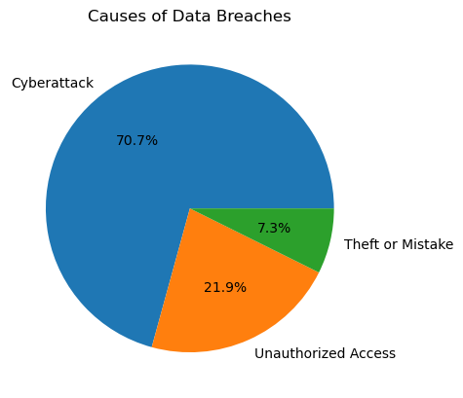
Statistical Discoveries
Percentages relative to the number of each type of data breach cause.
Cyberattacks is the highest, which is good in a way.
Notes:
Physical security should prevent the smaller to breach causes, physical security methods and laws are well-established and reliable.

Slide 9
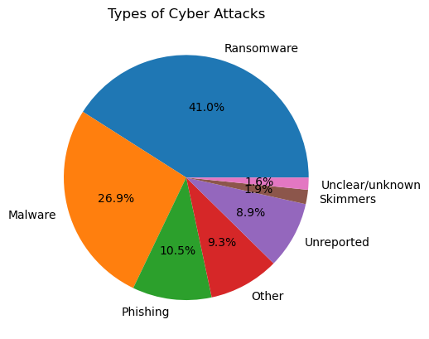
Statistical Discoveries Cont.
Ransomware seems to be the approach of choice for attackers, with Malware not being too far behind.
Notes:
Phishing being low is good, phishing should be included in training and policies and well-established. Unreported means organization did not make a selection.

Slide 10
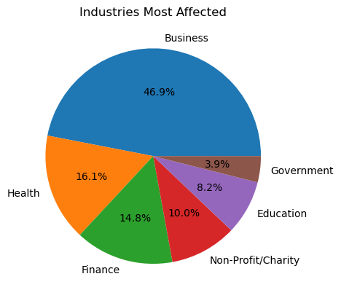
Statistical Discoveries Cont.
Business is the highest by far.
Breaches distributed across other industries are relatively low in comparison.
Notes:
with common sense the reason is easy to surmise I will not speculate here.

Slide 11
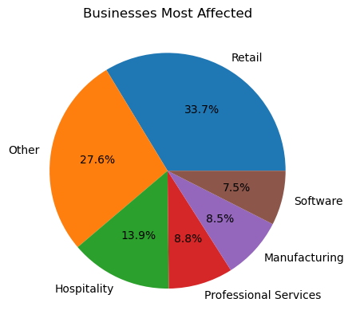
Statistical Discoveries Cont.
Excludes several categories below software, which were breached 20 or less times total.
Other is a close second category. Here I will suggest that perhaps there is a better way to handle categorization or input.
Notes:
Retail is at the top, which I feel again may have an obvious cause. Other should indeed require some investigation because a category that vulnerable should be able to be identified, described, and managed.

Slide 12
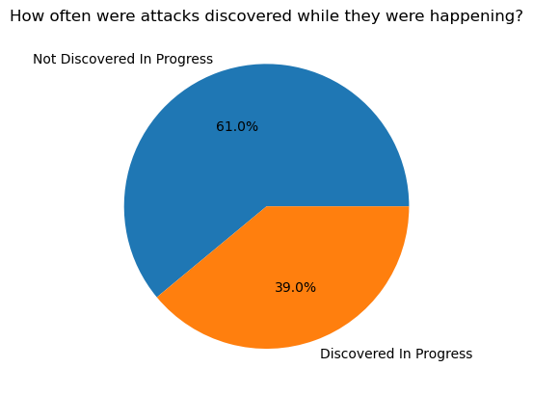
Patterns
Most of the time an attack was not discovered in progress.
Additional information may help put this to use.
Notes:
Whether or not the organization was using an intrusion detection/intrusion protection device

Slide 13
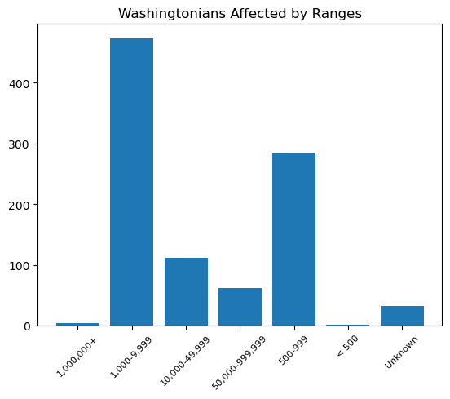
Patterns Cont.
Notes:
Size of db may indicate level of security for an attacker, therefore number affected is falls on smaller end.
not suggestions for conclusions but mere ideas with which to begin an investigation into finding a definite conclusion
It would be very useful to know if the organization was utilizing a honeypot or not to secure their network.

Slide 14
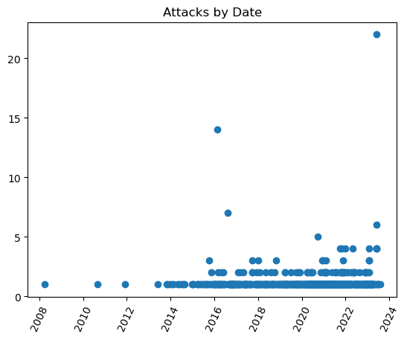
Patterns Cont.
Unique date against the number of breaches that occurred on that date.
Most dates only have 1 attack with occasional 2 or 3.
Notes:
The outliers here are large comparitively and it may be tempting to conclude that those were coordinated attacks, especially if the manner in which each breach occurred were the same.
The indicators on the bottom axis are seperated biannually and serve as a general organizational structure.
There is one outlier not included in this data which I will explore further.

Slide 15
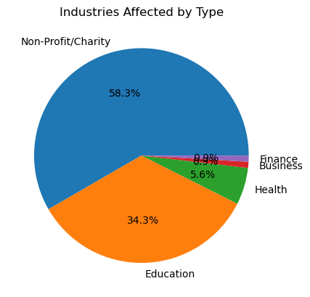
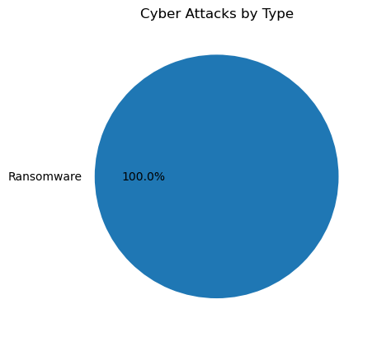
Outliers and Major Discoveries
On 2022-02-07 there were 108 breaches conducted on a variety of organizations in the same manner(seen below).
Notes:
Interestingly enough the largest portion of those affected were Non-Profit/Charity, which does not seem to follow the overall pattern of breaches recorded in the database.
There is plenty of inferential/circumstantial evidence to suggest that this was a coordinated attack, but that statement cannot be made without further investigation.
I could find very little to no articles on the event and none of them directly related to Washington State.

Slide 16
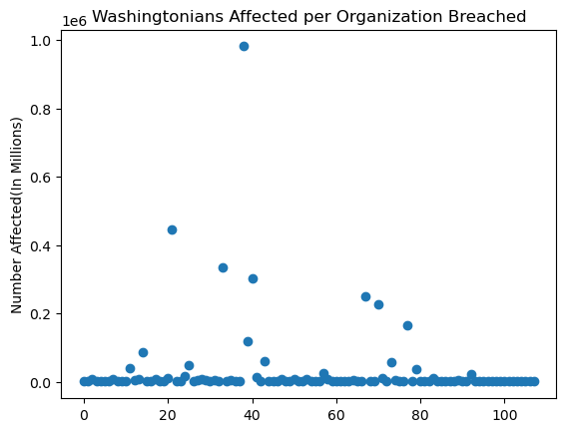
Outliers and Major Discoveries Cont.
For each individual organization breached on the given date, how many Washingtonians were affected.
most of these organizations had a breach affecting less than 50,000 people.
The single greates outlier makes up 1/3 of the total number affected.
The Feb 07 2022 breaches, together(3460534) were greater than the single greatest breach that occured(3243664) by 216870 people!

Slide 17
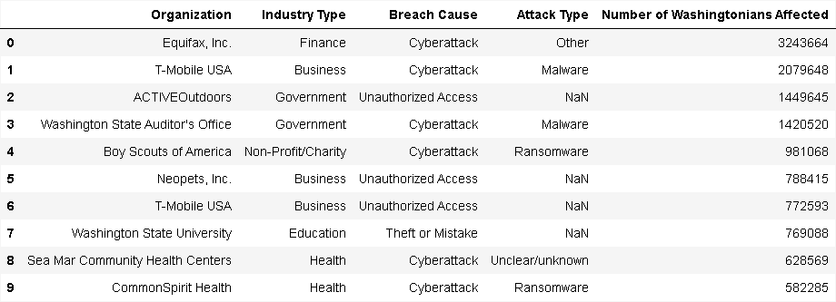
Outliers and Major Discoveries Cont.
Below is a small table, containing information on the top 10 largest data breaches recorded.
Notes:
Interestingly enough, the marginally small causes of data breaches as we've seen above, have ended up amongst the top 10 largest data breaches, and goes to show that every single breach should be handled with attention.

Slide 18
Closing
In closing, the exploration and analysis was a success.
Despite this success, there are a number of aforementioned categories of information that, if added, would provide an even more whole and useful collection of information related to data breaches in Washington State.
Notes:
I have tried not to draw definitive conclusions but to only make suggestions and provide a certain amount of direction to the imagination that might assist in exploring the matter further and may help others to take affirmative action against data breaches using this information.
Thank you for your time and attention.

